Slide 1

Decision Tree
A Start to Machine learning
SynchImpact Inc.

Slide 2
Interactions of Functions to Layers of Decision Making
Marketing
Finance
Operations
HR
Systems
Strategy
Area of Focus
Tactic
Operations
Synch Impact Inc.

Slide 3
Supervised Vs Unsupervised Learning
You use an algorithm to learn the mapping function of input variables (x) and an output variable (Y)
Y = f(X)
Decision Tree
Regression
In Unsupervised learning you only have input data (X) and no corresponding output variables.
The goal is to find pattern in the existing data and model the underlying structure.
Clustering
Association Rules
SynchImpact Inc.

Slide 4
Terminologies
Root Node
Parent/Child Node
Branch
SPLITTING
Decision Node
Decision Node
Terminal Node
Decision Node
Terminal Node
Terminal Node
PRUNING
Terminal Node
Terminal Node
SynchImpact Inc.

Slide 5
Types of Decision Trees & Terminology
Tree
Categorical
Continuous
Dependent Variable - Categorical
Classifier –DecisionTreeClassifier
Distinct & Non-overlapping regions
Top-Down Greedy Approach
Prediction Metrics: Mode of Node
Robust Model
Dependent Variable
Regressor –DecisionTreeRegressor
Distinct & Non-overlapping regions
Top-Down Greedy Approach
Prediction Metrics: Mean of Node
Better Models available
SynchImpact Inc.

Slide 6
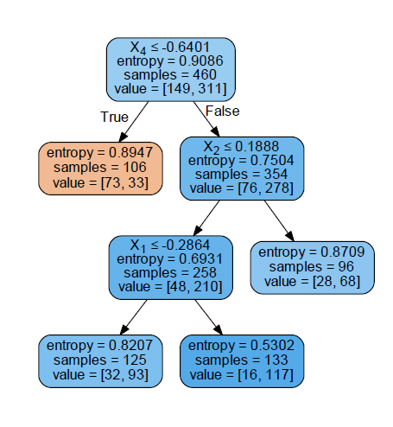
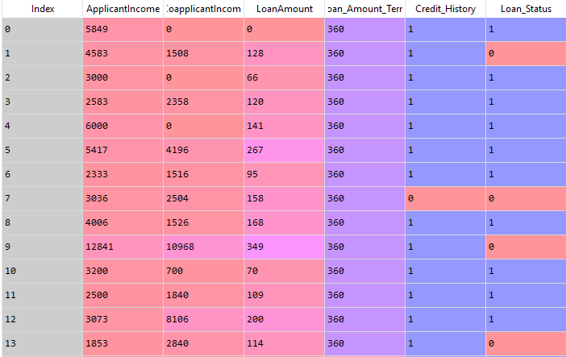
Peep Into the Real World
SynchImpact Inc.

Slide 7
Splitting Mechanism
Gini Index (CART)
Information Gain (Entropy)
Chi Square Test (CHAID)
Reduction of Variance
SynchImpact Inc.

Slide 8
Constraints
Minimum Samples for Node Split
Minimum Samples for a Terminal Node
Maximum Depth of the Tree
Maximum Number of Terminal Nodes
Maximum Features to Consider
SynchImpact Inc.

Slide 9
Advantages & Disadvantages
Easy to understand and hence widely accepted in business
Non parametric method
Immune to anomalies in data
Data type constraint is not there
Very useful as data exploration method
Overfitting issue
Not a robust model for continuous variables
SynchImpact Inc.

Slide 10
Lets Start!
Import the Libraries & the File
import numpy as np
import pandas as pd
import os
os.chdir("C:\\Users\\..\\Python")
os.makedirs("C:\\Users\\..\\Python\\temp")
os.getcwd()
loan = pd.read_csv(‘C:/../loan_prediction.csv’)
Descriptive Staistics
loan.head()
loan.groupby('Loan_Amount_Term').count()
loan.groupby('Loan_Status').count()
loan.isnull().sum(axis=0)
SynchImpact Inc.

Slide 11
Next Leap!
Lets Separate our Dependent Variable from the Independent Variable
X = loan.iloc[:, :5].values
y = loan.iloc[:, 5:].values
We Need a Test Dataset to look at our Prediction Accuracy
from sklearn.cross_validation import train_test_split
X_train, X_test, y_train, y_test = train_test_split(X, y, test_size = 0.25, random_state = 0)
Lets Remove the unnecessary advantage of the variables with Higher Values
from sklearn.preprocessing import StandardScaler
sc = StandardScaler()
X_train = sc.fit_transform(X_train)
X_test = sc.transform(X_test)
SynchImpact Inc.

Slide 12
Our Data Is Ready!
Fitting Decision Tree Classification to the Training set
from sklearn.tree import DecisionTreeClassifier
classifier = DecisionTreeClassifier(criterion = 'entropy’, #’gini’
max_depth = d,
min_samples_split = n,
min_samples_leaf = x,
max_features = None,
max_leaf_nodes = y,
random_state = 0)
classifier.fit(X_train, y_train)
SynchImpact Inc.

Slide 13
Our Model Is Ready!
Let’s Predict the Test set results
y_pred = classifier.predict(X_test)
from sklearn.metrics import confusion_matrix
cm = confusion_matrix(y_test, y_pred)
print(cm)
SynchImpact Inc.

Slide 14
Lets See how the tree Looks Like!
from sklearn.externals.six import StringIO
from sklearn import tree
from sklearn.tree import export_graphviz
from IPython.display import Image
import pydotplus
dot_data = StringIO()
export_graphviz(classifier, out_file=dot_data,
filled=True, rounded=True,
special_characters=True)
graph = pydotplus.graph_from_dot_data(dot_data.getvalue())
graph.write_pdf('loan_tree.pdf')
SynchImpact Inc.

Slide 15
Special Topics to Improve Model Efficiency
Bagging
Boosting
Feature Engineering
Variable Transformation
Principal Component
Hyperparameter Optimization
SynchImpact Inc.

Slide 16
Happy Learning!

